Slide 1

Sensation Park Entertainment Group
Independence Day Festivities in Canada, Mexico, and the U.S.

Slide 2
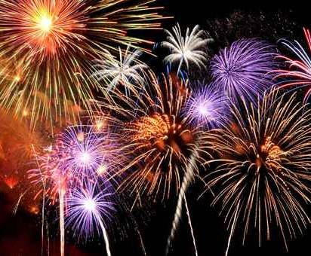
Get Ready for 2016!
Sensation Park Entertainment Group will be hosting special Independence celebrations at parks in the United States, Canada, and Mexico.

Slide 3
Schedule of Events
Canada
July 2019
U.S.
July 2019
Mexico
September 2019

Slide 4
A Different Event Each Week!
Week 1
Buy one entrance fee, get one free
Week 2
Free 5x7 group or individual photo
Week 3
25% park entrance discount
Week 4
25% discount on food and beverages

Slide 5
Contact Information
Sophia Ackerman
United States
Joseph Mercado
Mexico
Michael Lewis
Canada

Slide 6

Get Ready to Celebrate!
With Sensation Park Entertainment Group

